Slide 1
Reliable Air Travel; Stratified Analysis of Flight Delay
DAVID OJOMO
M.Sc. Data Science Student
University of Hertfordshire
Github link: https://github.com/davidojomo/Flight-Delay-Analysis-MSc-Project/tree/main

Slide 2
Introduction
Motivation
This project, “Reliable Air Travel; Stratified Analysis of Flight Delay,” aims to explore how reliability interact within the air travel industry.
The study will look at the main factors that influence delays in domestic flights within the United States and how these vary between different routes.
It will also test how well machine learning models can predict flight delays using operational data, and how these predictions may differ across routes and airlines.
Research question
What are the key factors influencing departure and arrival delays in domestic U.S. flights, and how do these vary by airline and airport?
To what extent do machine learning models predict flight arrival delays based on operational and environmental features, and how do these predictions differ across airlines and routes?

Slide 3
Overview of previous work
Title | Authors | Methods
Characterization and prediction of air traffic delays | (Rebollo & Balakrishnan, 2014) | k-Means clustering, Random Forests, Regression
Predictive Modeling of Flight Delays at an Airport Using Machine Learning Methods | (Hatıpoğlu & Tosun, 2024) | Logistic Regression, Naïve Bayes, Neural Networks, Random Forest, XGBoost, CatBoost, and LightGBM
Optimizing Flight Delay Predictions with Scorecard Systems | (Jacyna-Gołda et al., 2025) | operational forecasting Scorecard
Flight Delay Prediction Using Machine Learning | (Reddy et al., 2023) | SVM, Random Forest, Regression Decision Tree
Flight delay forecasting and analysis of direct and indirect factors | (Wang et al., 2022) | attention mechanism (LSTM-AM)
- Bibliography of references included at the end of the presentation

Slide 4
How does the project compare to the previous work?
Broader scope: Compare delay patterns across airlines and airports using detailed time, flight, and cause data offering broader insights than prior studies focused on single airlines or the entire system.
Sharper insights: Assess prediction accuracy to reveal key operational delay factors.
Real world impact: Handle class imbalance, highlight feature importance, and link findings to practical airline decisions.

Slide 5
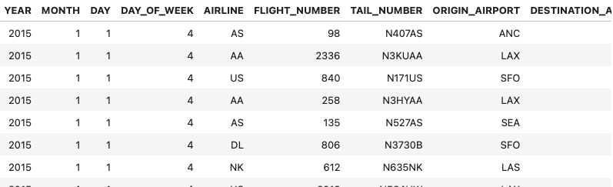
Dataset
Type of files - .csv files of flights data, airports and airlines
Size of the files - USA flights delay data (5.8 million rows, 592 MB), airports (24 KB), airlines (359B)
https://www.kaggle.com/datasets/usdot/flight-delays

Slide 6
Ethical implications
No personal data
Consent was obtained to use the data for this project – The data is from a public website and has a public GitHub License.
Data is anonymized
Data storage - secure

Slide 7
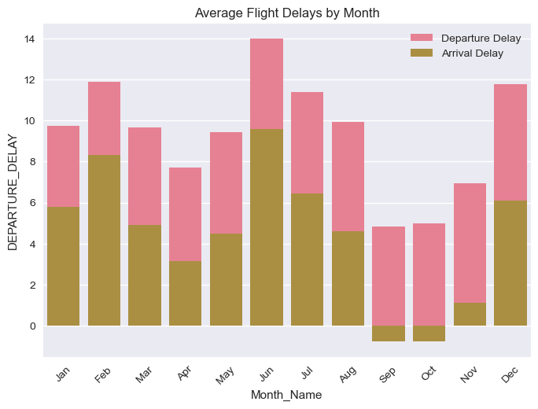
EDA
Flight Statistics
Total flights: 5,819,079
Cancelled Flights: 89,884 (1.54)%
Diverted Flights: 15,187 (0.26)%
Ontime Flights: 3,606,117 (61.97)%

Slide 8
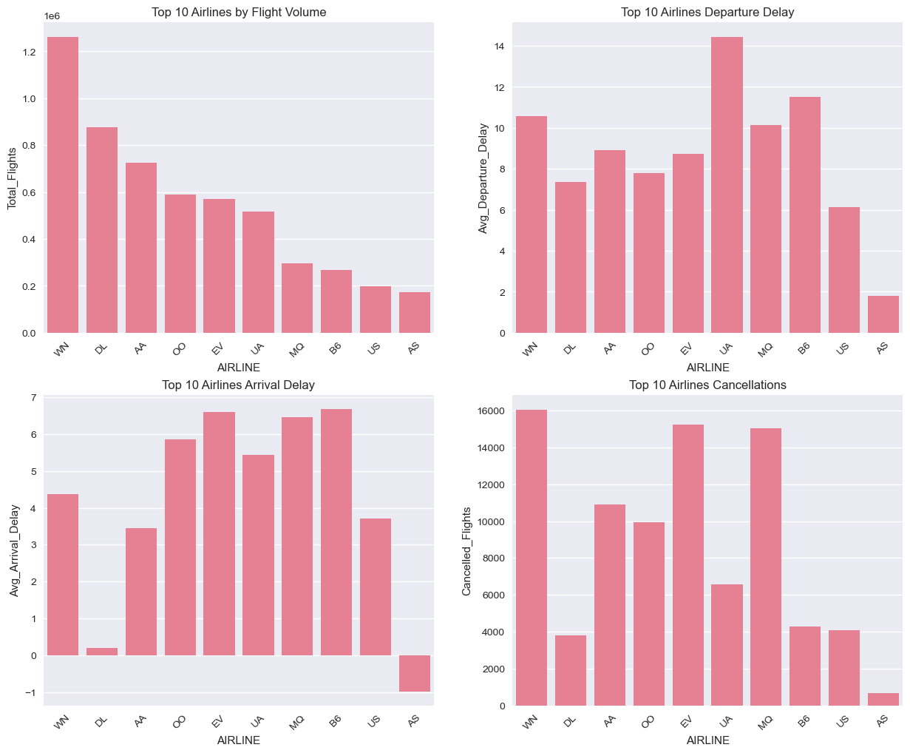
EDA
Airline Statistics
Top 3 airlines by flight volume - Southwest Airlines, Delta Airlines and American Airlines
Top 3 airlines by departure delay - United Airlines, Southwest Airlines and JetBlue Airways
Airlines with least departure and arrival delay - Alaska Airlines

Slide 9
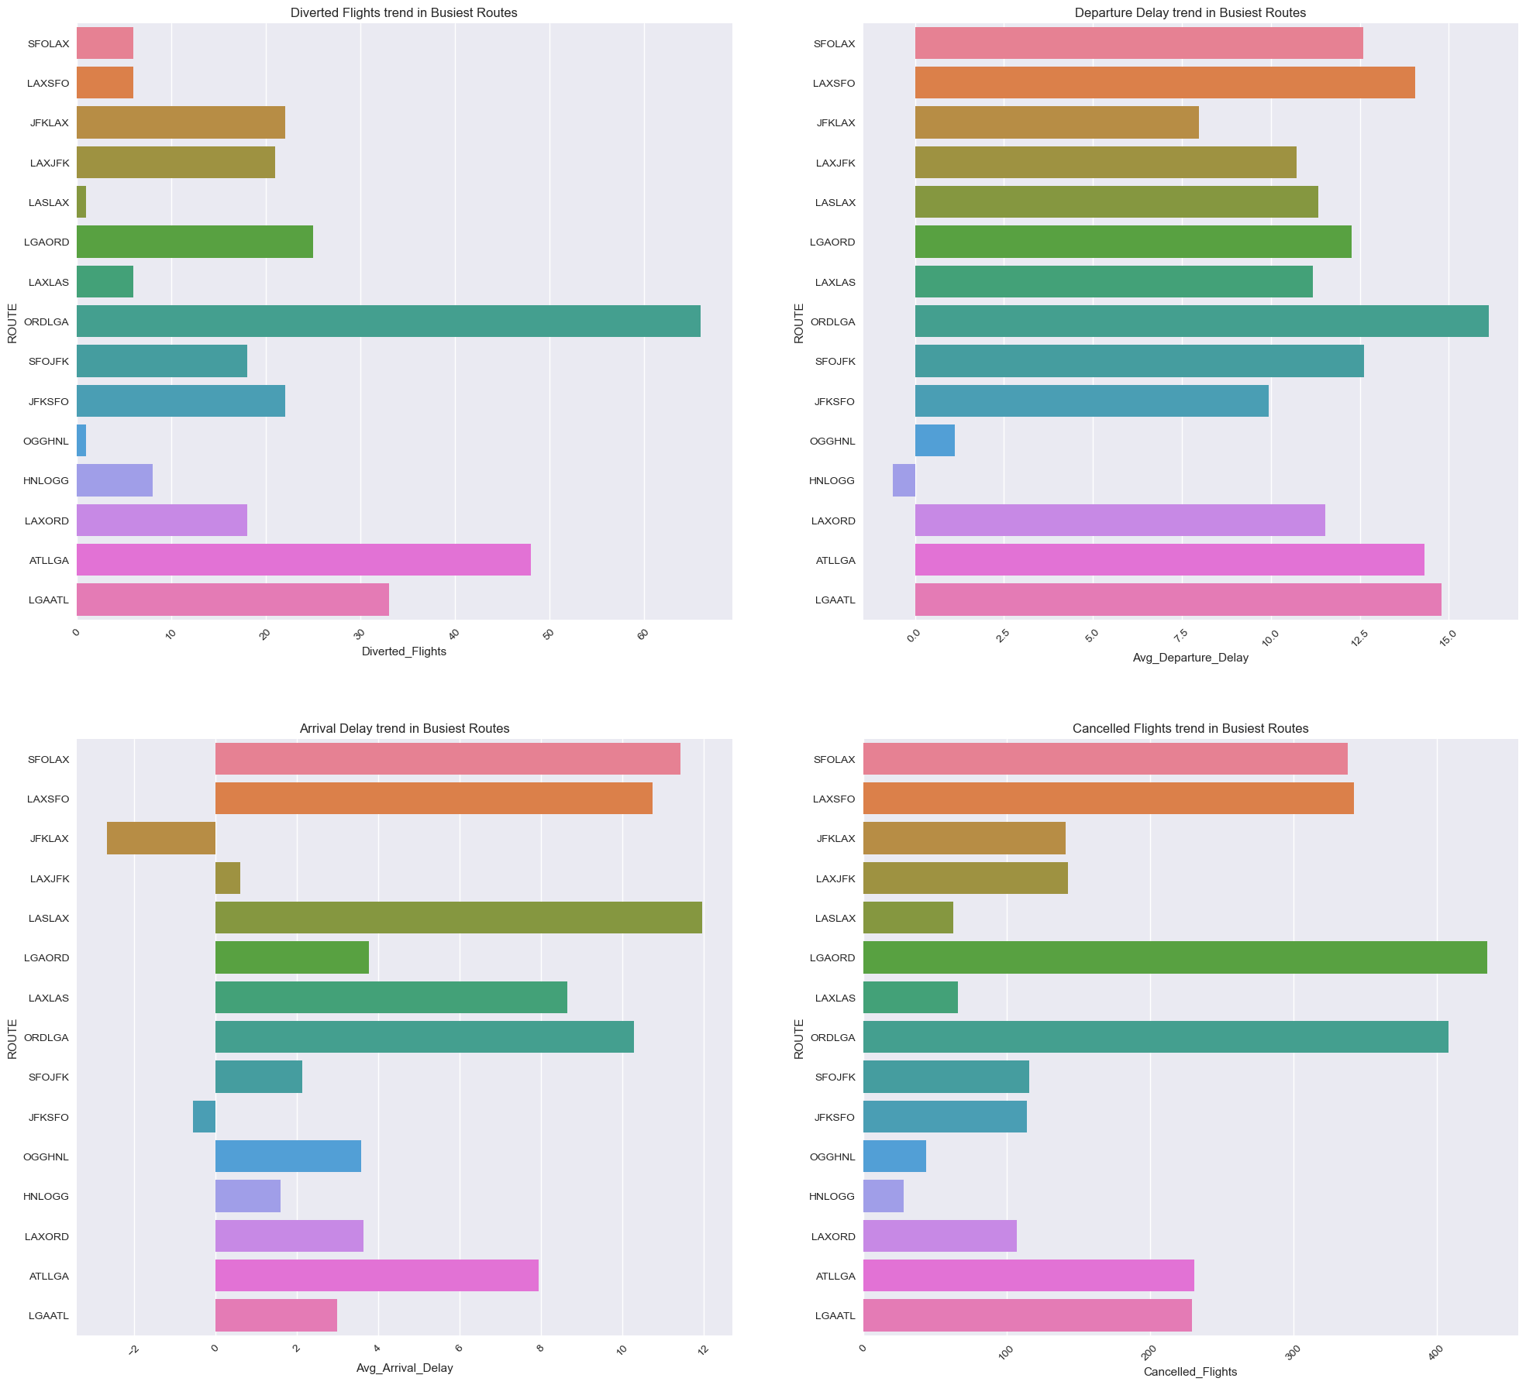
EDA
Route Statistics
Routes with maximum departure delay - Chicago-La Guardia NYC and La Guardia NYC-Atlanta
Routes with least departure delay - Maui-Honolulu, Hawaii

Slide 10
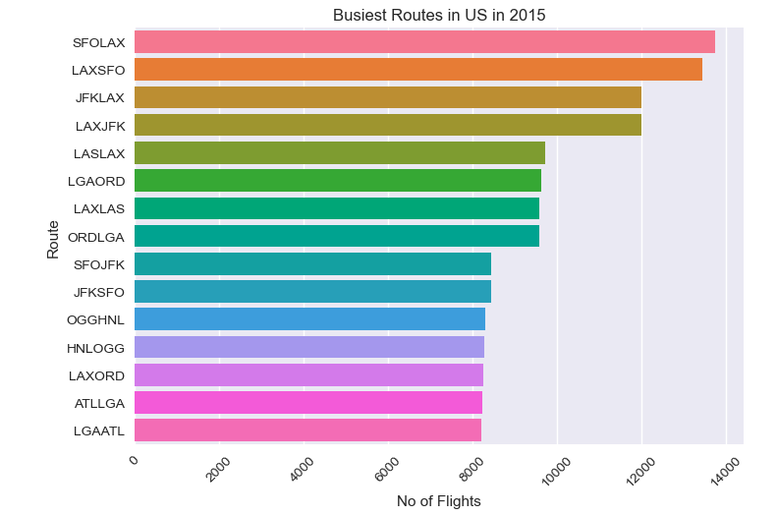
EDA
Route Statistics
Top 3 busiest routes – San Francisco-Los Angeles, Los Angeles-San Francisco, NYC-Los Angeles

Slide 11
Data Balancing
Dataset is imbalanced: 81.83% on-time flights vs 18.17% delayed flights
Without balancing, models would bias toward predicting "on-time" for everything
Used class_weight='balanced' parameter in sklearn models
Automatically adjusts weights inversely proportional to class frequencies
Recommended by research literature (Esmaeilzadeh & Mokhtarimousavi, 2020)
Code:
rf_model = RandomForestClassifier(
n_estimators=100,max_depth=15,
min_samples_split = 100,
min_samples_leaf = 50,
class_weight = 'balanced',
random_state=42, n_jobs=-1)

Slide 12
Pre-processing
Raw Data (5.8M flights, 30 columns)
↓
Feature Engineering (7 new features created)
↓
Label Encoding (7 categorical → numerical)
↓
RFE Feature Selection (16 → 12 features)
↓
Train-Test Split (80/20 stratified)
↓
Ready for Modeling
Data Augmentation: No synthetic augmentation used; Class weighting applied instead to handle imbalance efficiently while preserving 5.8M real-world flight records

Slide 13
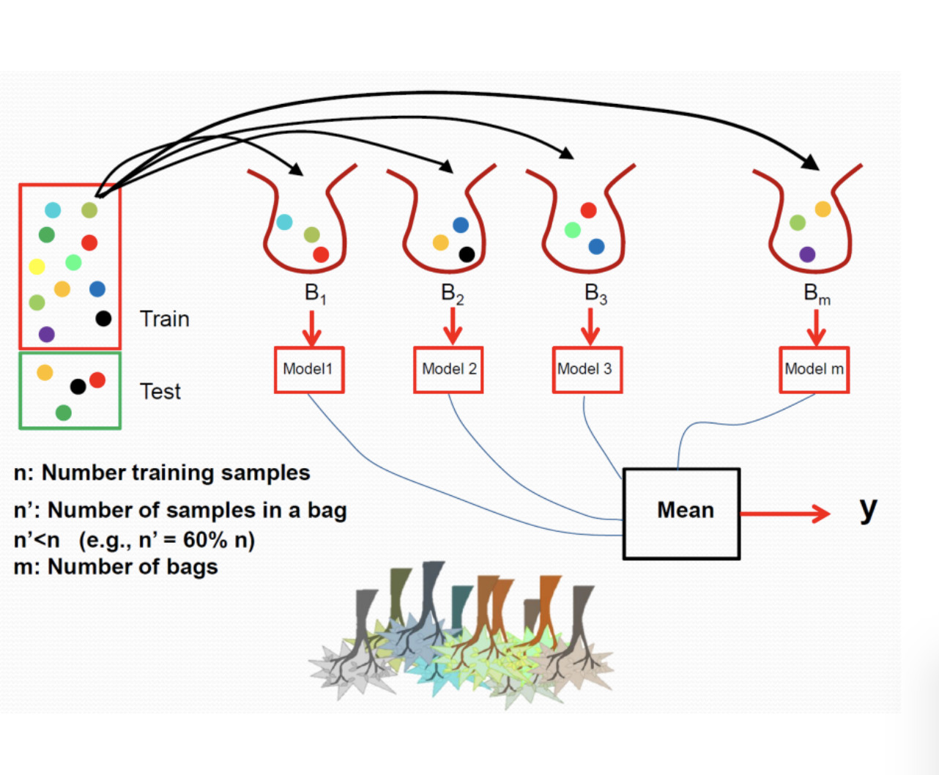
Model used
Random Forest:
Ensemble method that builds multiple independent decision trees on random data subsets.
With each tree voting on the final prediction; reduces overfitting through averaging and provides built-in feature importance rankings
Why Used:
Robust to imbalanced data when combined with class weighting; Provides interpretable feature importance for RQ1 analysis.
Source: Lecture 2 Page 74 of Machine Learning and Neural Networks

Slide 14
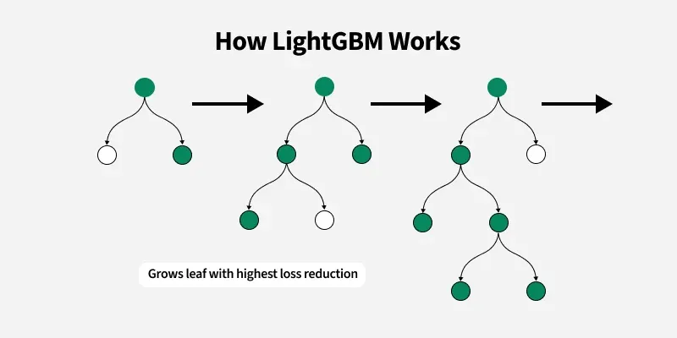
Model used
Light GBM:
Sequential ensemble method where each tree corrects errors from previous trees; uses efficient leaf-wise growth strategy optimized for large datasets and faster training
Why Used:
Handles large datasets efficiently; Often achieves higher accuracy than Random Forest.
Supports class imbalance through scale_pos_weight parameter; Fast training time despite dataset size
Source: LightGBM (Light Gradient Boosting Machine), https://www.geeksforgeeks.org/machine-learning/lightgbm-light-gradient-boosting-machine/

Slide 15
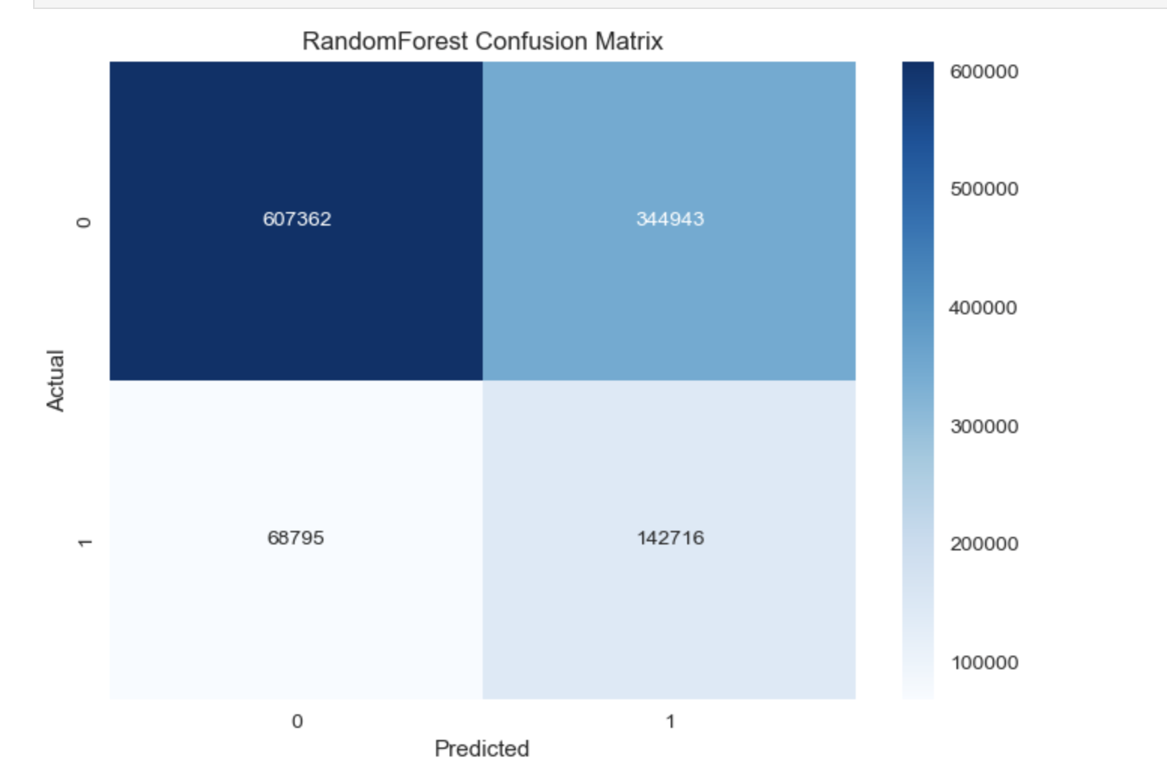
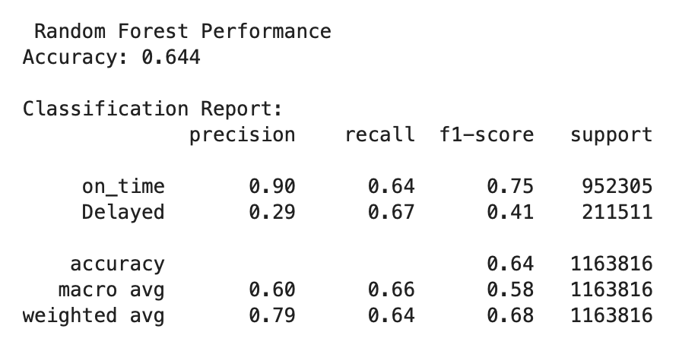
Model result
Random Forest Performance
Accuracy: 64% with balanced precision-recall trade-off for both delayed and on-time classes
Strong feature importance extraction capability, identifying DISTANCE, TAXI_OUT, and SCHEDULED_HOUR as top predictors
Robust generalization with consistent performance across different data subsets; minimal overfitting due to ensemble averaging

Slide 16
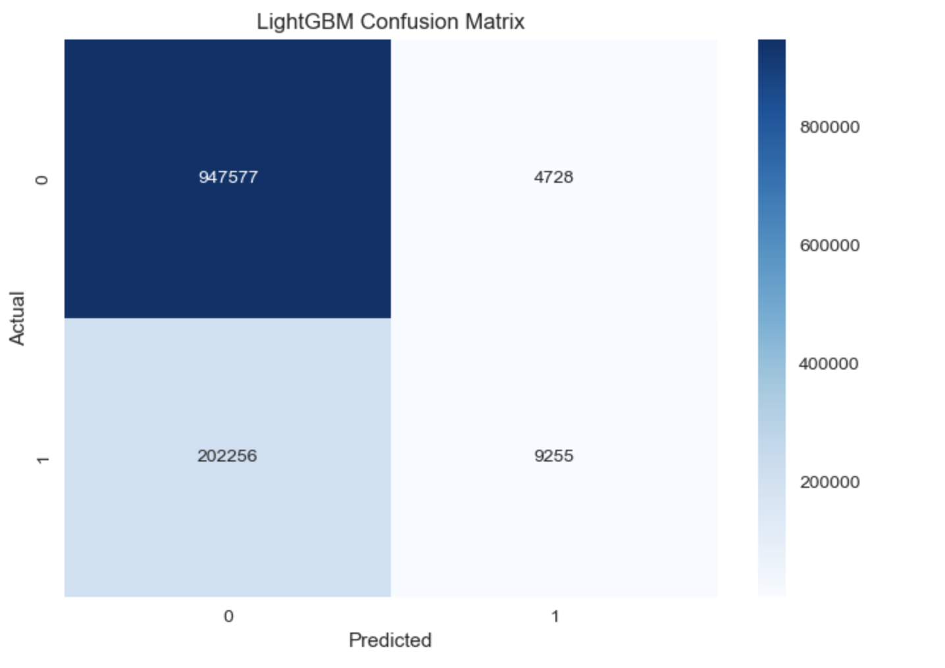
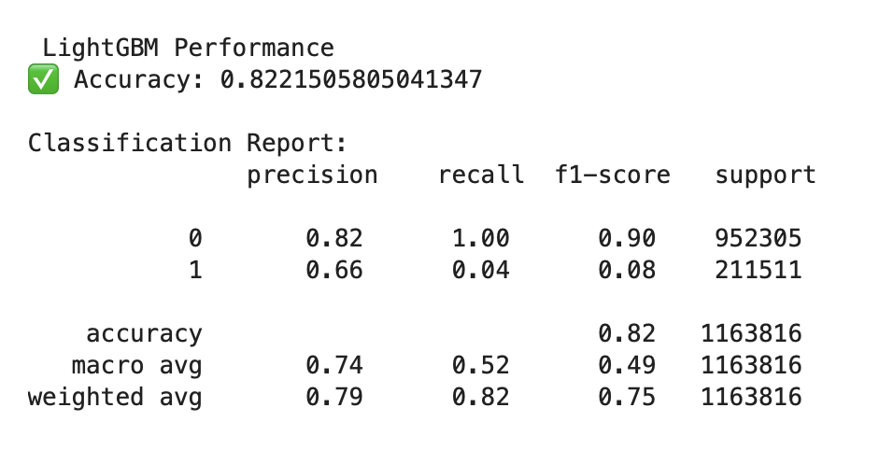
Model result
Light GBM Performance:
Higher accuracy than Random Forest due to sequential error correction and optimized boosting
Faster training time (50% reduction) despite large dataset size (5.8M samples) through efficient leaf-wise tree growth
Superior handling of complex non-linear patterns with better recall for minority class (delayed flights)

Slide 17
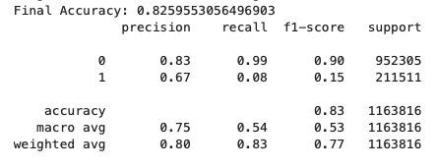
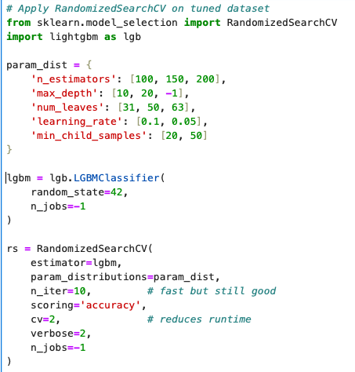
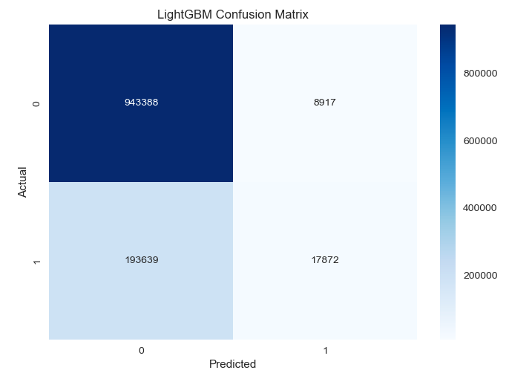
Hyperparameter tuning
Applied RandomizedSearchCV on Light GBM for faster and efficient parameter optimization; accuracy improved marginally from baseline, confirming model robustness
Explored Random Forest hyperparameter tuning but discontinued due to excessive computational time
Tuning parameters included n_estimators, max_depth, learning_rate, and min_samples_split; optimized for F1-score

Slide 18
Analysis
Satisfied with 82-83% accuracy; Random Forest (64%) served its purpose for feature importance analysis (RQ1); Light GBM performance is operationally useful and aligns with aviation research standards
82-83% accuracy is good and operationally valuable; correctly predicts 8 out of 10 cases with balanced performance across both delayed and on-time classes
Industry standard for delay prediction: 75-85% accuracy due to inherent complexity and unpredictable external factors
Next Steps
Experiment with other faster and efficient models such as XGB, Logistic Regression
Develop context-specific models per airline/airport (RQ2 analysis) which might typically achieve higher accuracy for targeted scenarios

Slide 19
Summary and conclusions
Summary - Applied Random Forest and Light GBM models to predict fight delay from features such as distance, day of week, season, Taxi_out etc.
Day of Week, Taxi_out, Distance and Month were top features influencing departure delay (RFE method) Results - Got 64% accuracy for Random Forest and 82% accuracy for Light GBM models
With hyperparameter tuning performance moderately increased as Light GBM already handles complex datasets well
What next?- Implement more models and conduct a stratified analysis of model performance by airline and airports

Slide 20
References
Esmaeilzadeh, E. and Mokhtarimousavi, S. (2020) “Machine Learning Approach for Flight Departure Delay Prediction and Analysis,” Transportation Research Record: Journal of the Transportation Research Board, 2674(8), pp. 145–159. Available at: https://doi.org/10.1177/0361198120930014.
Hatıpoğlu, I. and Tosun, Ö. (2024) “Predictive Modeling of Flight Delays at an Airport Using Machine Learning Methods,” Applied Sciences, 14(13), p. 5472. Available at: https://doi.org/10.3390/app14135472.
Jacyna-Gołda, I. et al. (2025) “Optimizing Flight Delay Predictions with Scorecard Systems,” Applied Sciences, 15(11), p. 5918. Available at: https://doi.org/10.3390/app15115918.

Slide 21
References
Rebollo, J.J. and Balakrishnan, H. (2014) “Characterization and prediction of air traffic delays,” Transportation Research Part C: Emerging Technologies, 44, pp. 231–241. Available at: https://doi.org/10.1016/J.TRC.2014.04.007.
Reddy, R.T. et al. (2023) Flight Delay Prediction Using Machine Learning, 2023 IEEE 8th International Conference for Convergence in Technology (I2CT). IEEE. Available at: https://doi.org/10.1109/I2CT57861.2023.10126220.
Wang, F. et al. (2022) “Flight delay forecasting and analysis of direct and indirect factors,” IET Intelligent Transport Systems, 16(7), pp. 890–907. Available at: https://doi.org/10.1049/itr2.12183.

